Slide 1

Moonraker
Visualizing Cloud Native Application Bundles
Chance Murray
Gabe Coelho
Madison Robertson
Grant Perdue
Dan Kindt

Slide 2
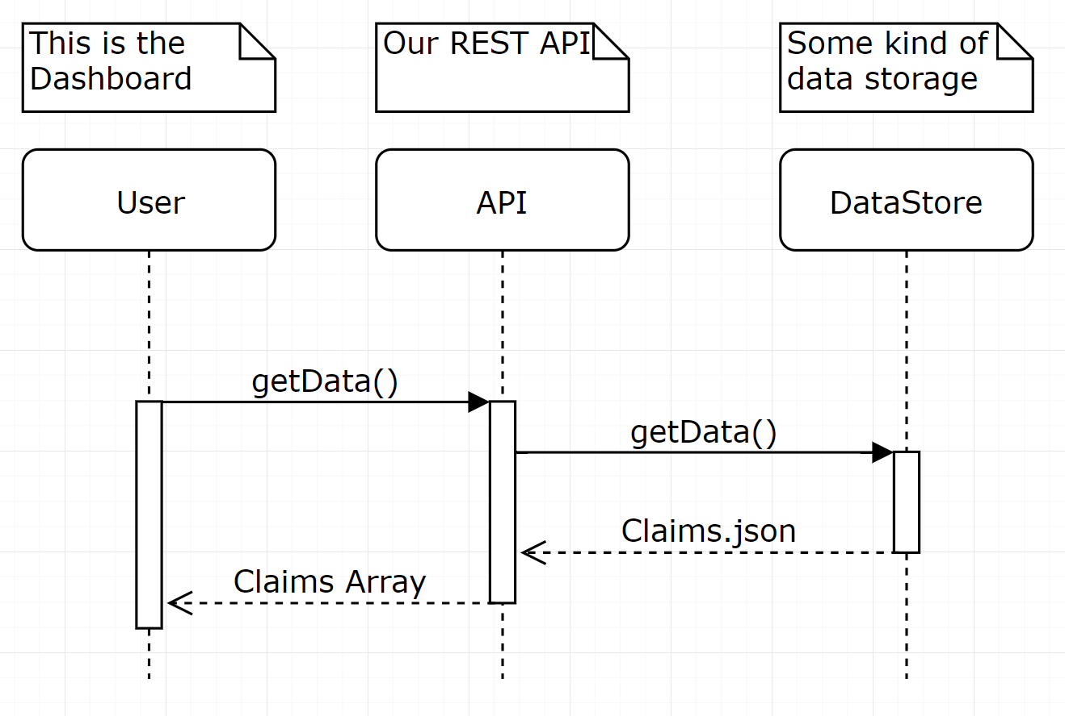
Modified High Level Logical Design
Vue.js Dashboard
The Proxy NodeJS
Sponsor’s Cloud Plugin
Proxy
Via RPC
Notes:
Mention our design changes from our discussion with Chia-Chi

Slide 3
Project Progress
Define project
Define project
Proof of Concept
April 10, 2020
Deliver final
API & Dashboard
October 6, 2019
December 6, 2019
November 1, 2019
February 15, 2020
Research
API & Dashboard (BETA)

Slide 4
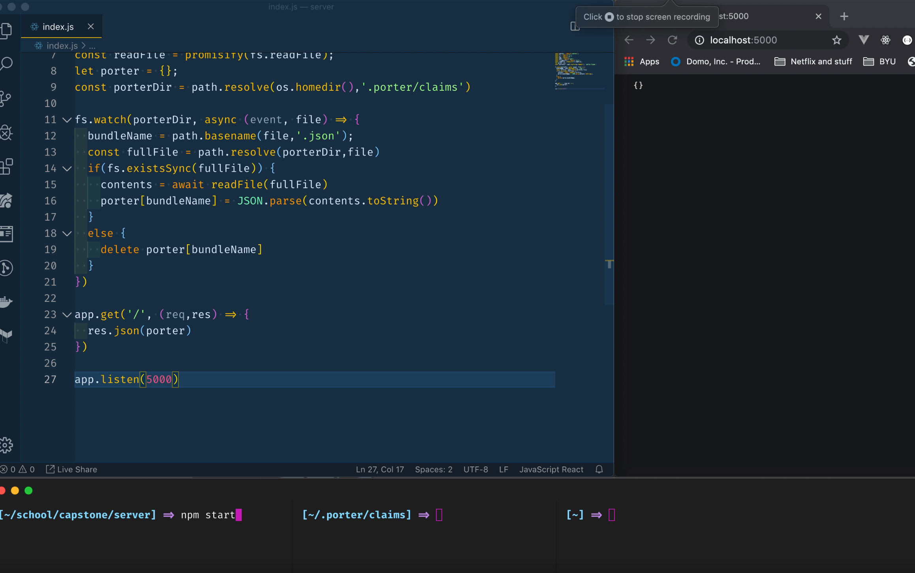
Demo (What we’ve accomplished so far)
Local implementation
CLI Commands in Node JS
API Design
Dashboard Mockup Vue.js
Notes:
We are still researching this!

